Slide 1









Page - 1
Project Report
Semester-IV (Batch-2022)
ITALIAN FOOD WEBSITE
Supervised By:
RAVEESH SAMKARIA
Submitted By:
Vansh Garg 2210990936 ( G-14 )

Slide 2
Page - 2
ABSTRACT
This project is a responsive website for an Italian restaurant, showcasing its diverse menu offerings and inviting ambiance. Developed using HTML, CSS, and JavaScript, the website delivers an immersive experience across devices, ensuring accessibility and ease of navigation. With captivating background images and carefully selected typography, the design reflects the elegance and authenticity of Italian cuisine. The menu section showcases a variety of traditional Italian dishes, accompanied by enticing visuals and detailed descriptions. Interactive features such as toggle buttons enable users to explore the menu effortlessly. The tech stack behind the project comprises robust web technologies, including HTML for structuring content, CSS for styling and layout, and JavaScript for interactivity and dynamic content rendering.
Overall, this project aims to capture the essence of Italian dining while offering a seamless and enjoyable browsing experience for visitors.

Slide 3
Page - 3
Table Of Contents
S.no | Title | Page No.
INTRODUCTION
1. | Background | Page 4 – 5
2. | Objectives | Page 5 – 6
3. | Significance | Page 6 – 7
PROBLEM DEFINITION & REQUIREMENTS
4. | Problem Definition | Page 8
5. | Software Requirements | Page 8 - 9
6. | Hardware Requirements | Page 9
PROPOSED DESIGN / METHODOLOGY
7. | Project Overview | Page 10
8. | File Structure | Page 10
9. | Content & Functionality | Page 11
10. | Responsive Design | Page 11
11. | UI Design | Page 12
12. | Conclusion | Page 12
RESULTS
13. | Code Snippets | Page 13 - 23
14. | Visual Outputs | Page 24 – 32

Slide 4
Page - 4
INTRODUCTION
The Italian Food Website project endeavors to leverage modern web development technologies to create an immersive and user-friendly online platform for a fictional Italian restaurant. In today's digitally-driven era, establishing a robust online presence is crucial for businesses to remain competitive and relevant. This project aims to address this need by combining cutting-edge web development techniques with the timeless appeal of Italian cuisine.
Background
Italian cuisine has long been celebrated for its rich flavors, diverse ingredients, and cultural heritage. As the restaurant industry evolves to meet the demands of a digital age, the importance of a captivating and functional website cannot be overstated. The Italian Food Website project seeks to fill this gap by providing a dynamic platform where users can explore the restaurant's offerings, make reservations, and engage with the brand from any device or location.

Slide 5
Page - 5
The Italian Food Website project endeavors to leverage modern web development technologies to create an immersive and user-friendly online platform for a fictional Italian restaurant. In today's digitally-driven era, establishing a robust online presence is crucial for businesses to remain competitive and relevant. This project aims to address this need by combining cutting-edge web development techniques with the timeless appeal of Italian cuisine.
Objectives
The objective of this project was to design a user-friendly and visually appealing landing page for a website selling food. The design aimed to achieve the following:
Develop a responsive website utilizing HTML5, CSS3, and JavaScript to ensure compatibility across various devices and screen sizes.
Increase website traffic and user engagement through a visually appealing and informative landing page.

Slide 6
Simplify the ordering process for improved user experience and conversion rates.
Establish a strong brand identity to create a memorable first impression and foster brand recognition.
Employ modern web development practices, including efficient code organization, optimized asset delivery, and browser compatibility testing, to enhance site performance and user experience.
Significance
Increased sales and conversions: The user-friendly interface and clear calls to action will guide customers through the ordering process seamlessly. High-quality food images will showcase your offerings enticingly, leading to increased product sales.
Enhanced Brand Awareness: The design incorporates a consistent visual identity, establishing a strong brand presence in the user's mind. This fosters recognition and memorability,
Page - 6

Slide 7
Page – 7
building brand loyalty for future purchases.
Improved User Experience: A clean and simple layout with intuitive navigation allows users to easily find the information they need, browse your menu, and complete orders effortlessly. This positive user experience increases customer satisfaction and encourages repeat visits.
Enhanced Brand Storytelling: The website design can be used to not only showcase your food offerings but also tell your brand story. You can use high-quality visuals, customer testimonials, or a dedicated "About Us" section to connect with your target audience on an emotional level. This brand storytelling can foster brand loyalty and create a sense of community around your food business.
Streamlined Operations: A well-designed website can streamline internal operations by simplifying order management and potentially reducing customer service inquiries.

Slide 8
Page - 8
Problem definition & Requirements
Problem Definition
While there are numerous websites showcasing Italian food, many lack a focus on user experience for mobile devices. Traditional website designs can be cluttered and difficult to navigate on smaller screens, making it frustrating for users seeking information about Italian cuisine.
There is a need for a website dedicated to Italian food that offers a mobile-friendly and engaging experience. This website should be easy to navigate and present information about Italian food in a compelling way, regardless of the device used to access it.
Software Requirements
Functional Requirements :-
The website uses HTML to structure content and CSS for visual presentation.

Slide 9
Page - 9
The website layout adapts (responds) to different screen sizes (desktop, mobile).
Users can easily access information about Italian food (e.g., popular dishes, regional specialties, ingredients).
High-quality images of Italian cuisine should be included and optimized for display on different devices.
Non-Functional Requirements :-
The website should be visually appealing and evoke the essence of Italian food culture.
The website should load quickly and efficiently, ensuring a smooth user experience.
The website code should be well-organized, commented, and maintainable for future updates.
Hardware Requirements
Any device with a web browser and internet connection can access the website.

Slide 10
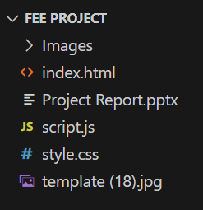
Page - 10
Proposed Design / Methodology
Project Overview
This project aims to develop a responsive website dedicated to Italian food. The website will utilize HTML for content structure and CSS for visual presentation, ensuring a user-friendly and engaging experience across various devices (desktop , mobile).
File Structure
The project will utilize a well-organized folder structure for efficient management and future updates.
index.html: Main HTML file containing the overall website structure and content
style.css: Primary CSS file for styling all website elements.
Images: Folder containing all images used on the website.
script.js: JavaScript file containing minor interactive elements

Slide 11
Page - 11
Content and Functionality
The website will offer informative and engaging content about Italian food:
Homepage: A visually appealing introduction featuring high-quality images of Italian dishes, a brief overview of Italian cuisine
About Italian Food: A dedicated section with informative text about Italian food culture, regional specialties, and key ingredients.
Popular Dishes: A section showcasing various popular Italian dishes with descriptions, high-resolution images.
Responsive Design Techniques
The website will utilize various techniques to ensure responsiveness across devices:
Media Queries: CSS media queries will be used to adapt the layout, font sizes, and image scaling based on screen size.
Flexbox & Grid Layout: Flexible CSS techniques will ensure the layout adjusts to various screens.

Slide 12
Page - 12
User Interface (UI) Design
The UI will prioritize a clean and intuitive design:
Clear Navigation: A simple navigation bar or menu will be implemented for easy access to different sections of the website.
Readability: A legible and user-friendly font will be chosen for all text content.
High-Quality Images: Visually appealing and high-resolution images will be used throughout the website.
Minimalistic Design: A clutter-free and visually balanced design will enhance user experience on smaller screens.
Conclusion
By following this design methodology and best practices for responsive web development, this project will create a user-friendly and engaging website dedicated to Italian food. The website's content and functionalities will be accessible and visually appealing across various devices

Slide 13
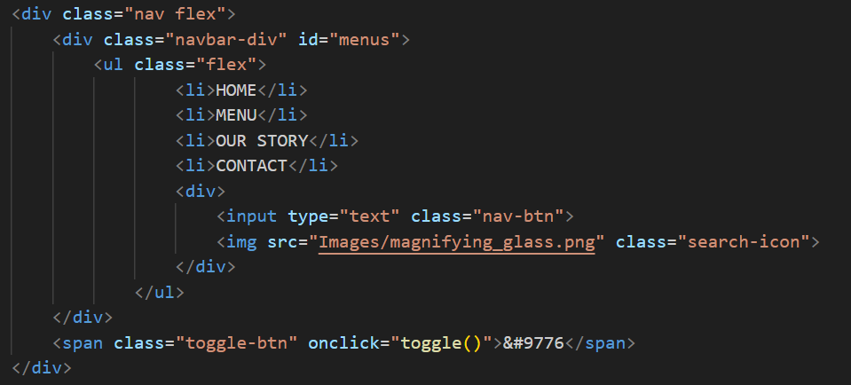
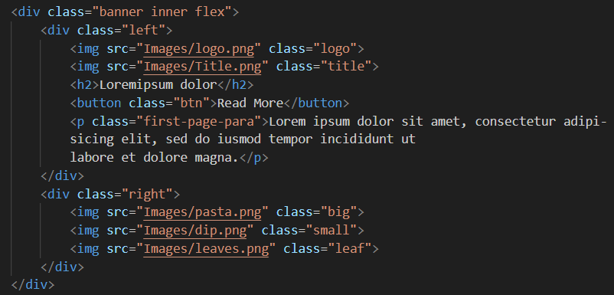
Page - 13
RESULTS
Code Snippets
Navigation Bar with Responsive Menu and Search Function
Homepage Section with Image and Text Content

Slide 14
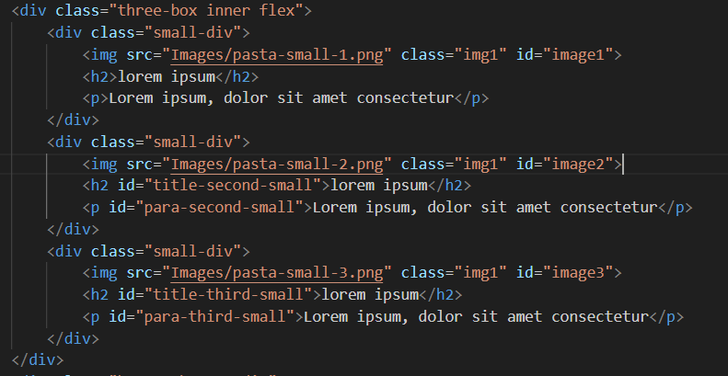
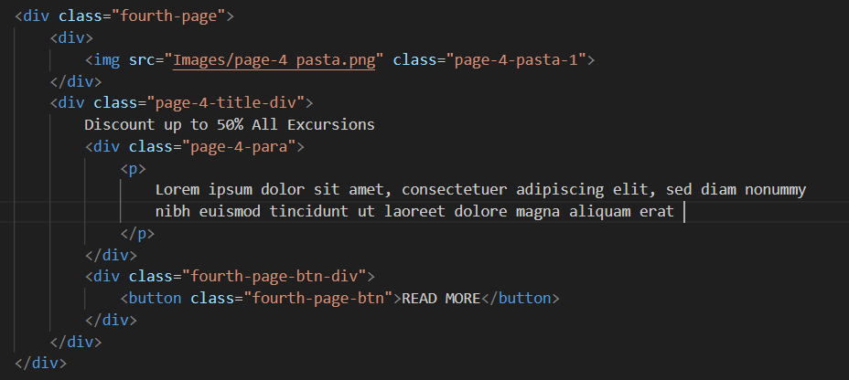
Page - 14
Explore Our Menu Section
"Excursions with Discount" Section

Slide 15
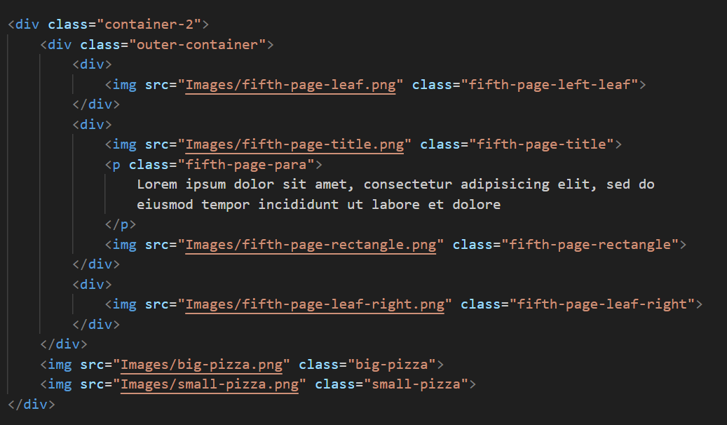
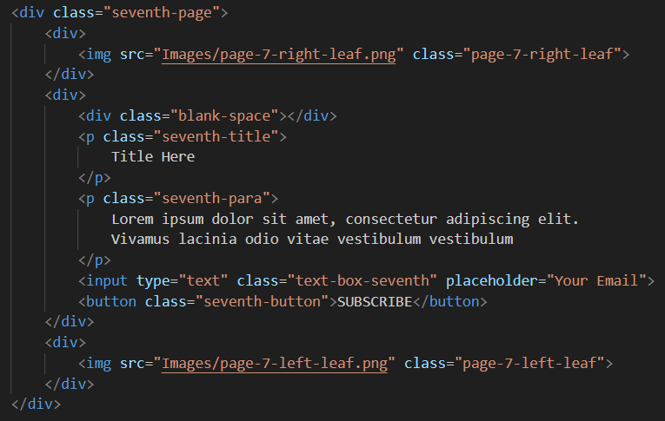
Page - 15
"A Slice of Italy" Section
"Stay Connected" Section

Slide 16
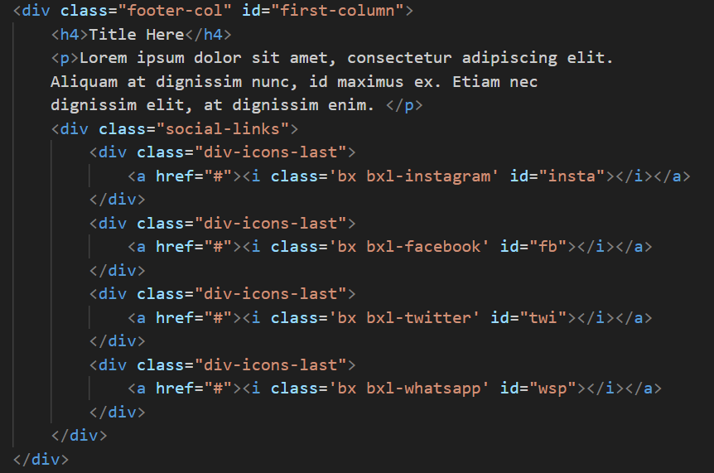
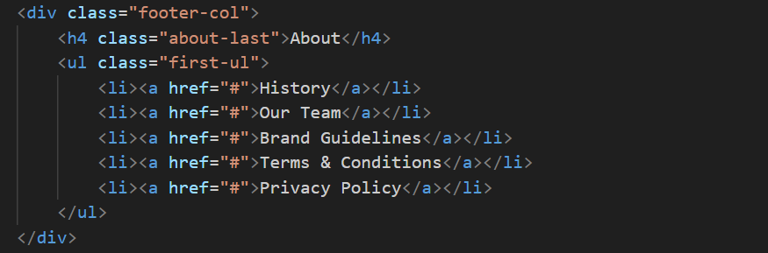
Page - 16
Footer Section
Social Media Links
Informative info about company (history, terms & conditions)

Slide 17
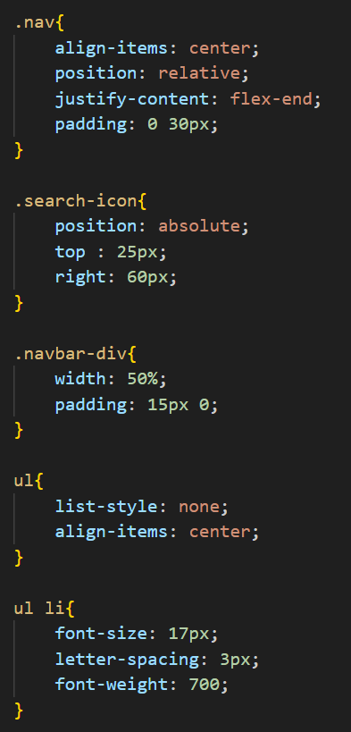
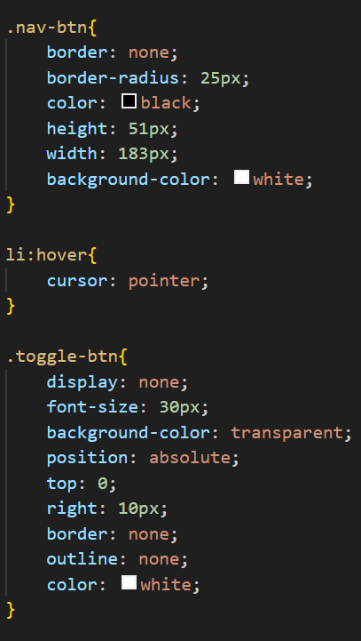
Page - 17
Transforming Your Website: A Look at Key CSS Code Snippets
Unlocking a Responsive Navbar: A Look at the CSS Code

Slide 18
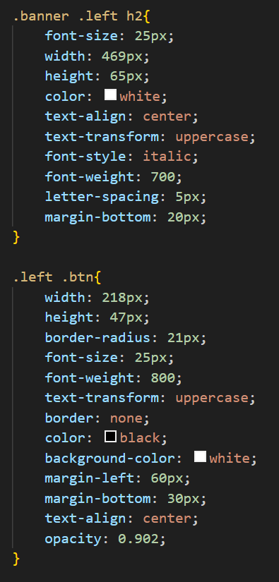
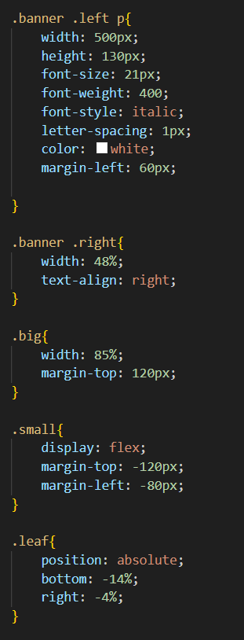
Page - 18
Bold and Beautiful Banner: CSS Code for a Striking First Page
This code snippet meticulously crafts the visual identity of the first-page banner. From the oversized, italicized headline to the contrasting button and elegant paragraph, each element is styled with purpose. The code ensures a clear hierarchy of information, drawing the viewer's eye to the call to action button.

Slide 19
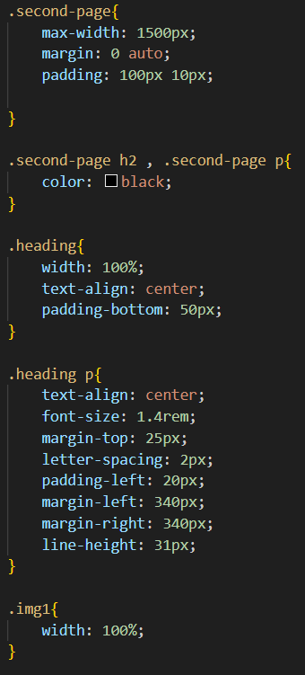
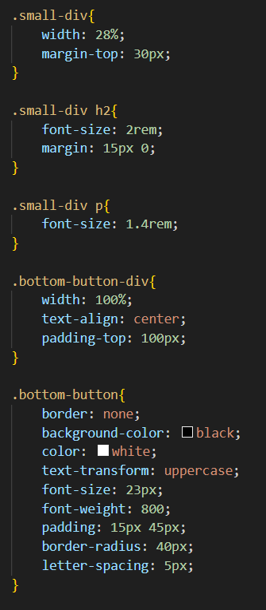
Page - 19
Unveiling the Product Page: A Breakdown of the CSS Code
This code snippet brings the product page to life, transforming the underlying structure into a visually appealing and user-friendly experience. It defines styles for various elements, likely including product images, titles, descriptions, pricing

Slide 20
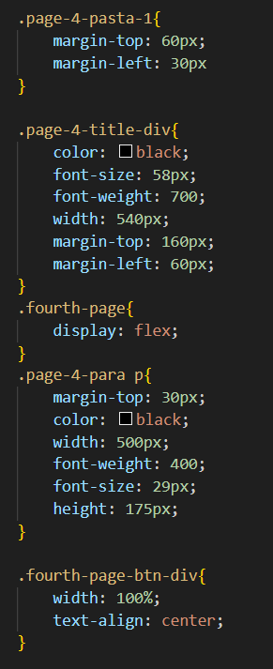
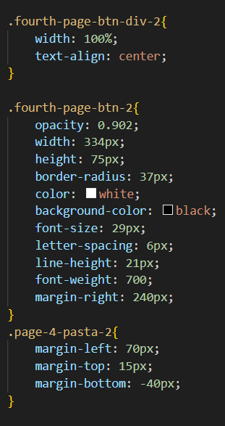
Page - 20
Pasta Perfection: CSS Code for the Fourth-Page Design
This code snippet serves up the visual style for the fourth page, likely dedicated to showcasing delectable pasta dishes. Large, bold headings and spacious paragraphs create a clear and inviting layout.

Slide 21
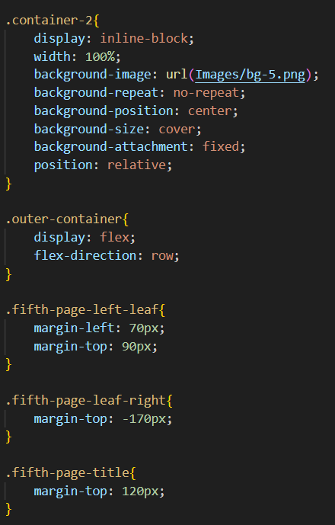
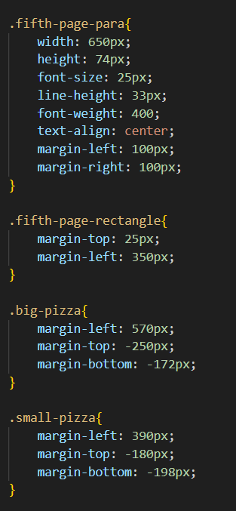
Page - 21
Pizza Perfection on a Plate: CSS Code for Product Display
This code snippet styles the presentation of individual pizzas on a restaurant website's menu. It likely defines styles for various elements that make up a pizza menu item, including the pizza image, title, description

Slide 22
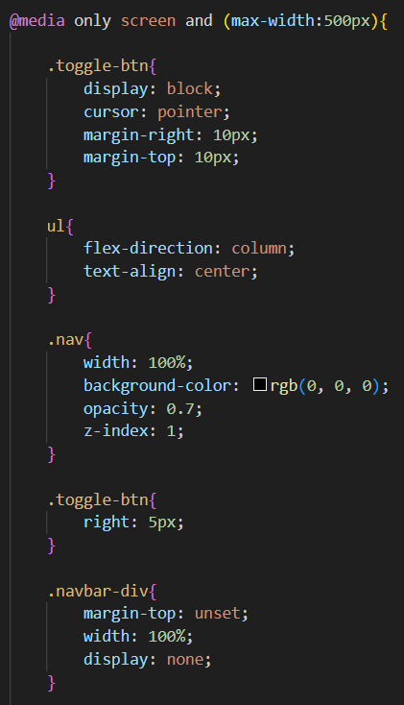
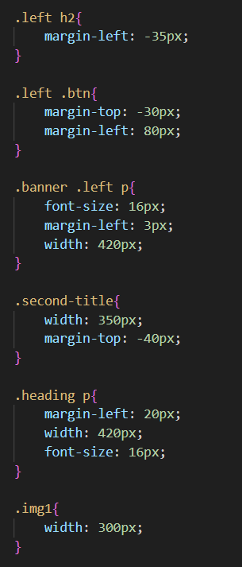
Page - 22
From Desktop to Mobile: Media Queries for a Seamless Experience
This code snippet ensures a smooth transition from desktop to mobile views. It utilizes media queries, a powerful CSS technique that adapts the website's styles based on the user's device screen size.

Slide 23
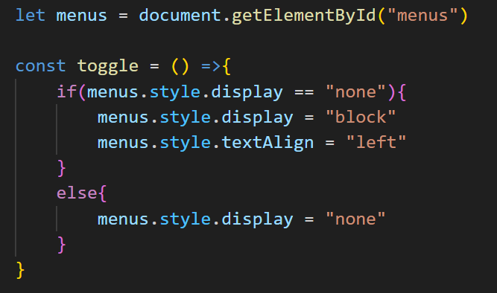
Page - 23
Navigating with Ease: JavaScript Code for a Responsive Menu Toggle
This code snippet plays a crucial role in creating a user-friendly mobile experience. It tackles the challenge of adapting a navigation bar for smaller screens. This simple yet effective JavaScript function ensures a smooth and responsive navigation experience for mobile users, allowing them to seamlessly access the website's menu with a tap.

Slide 24
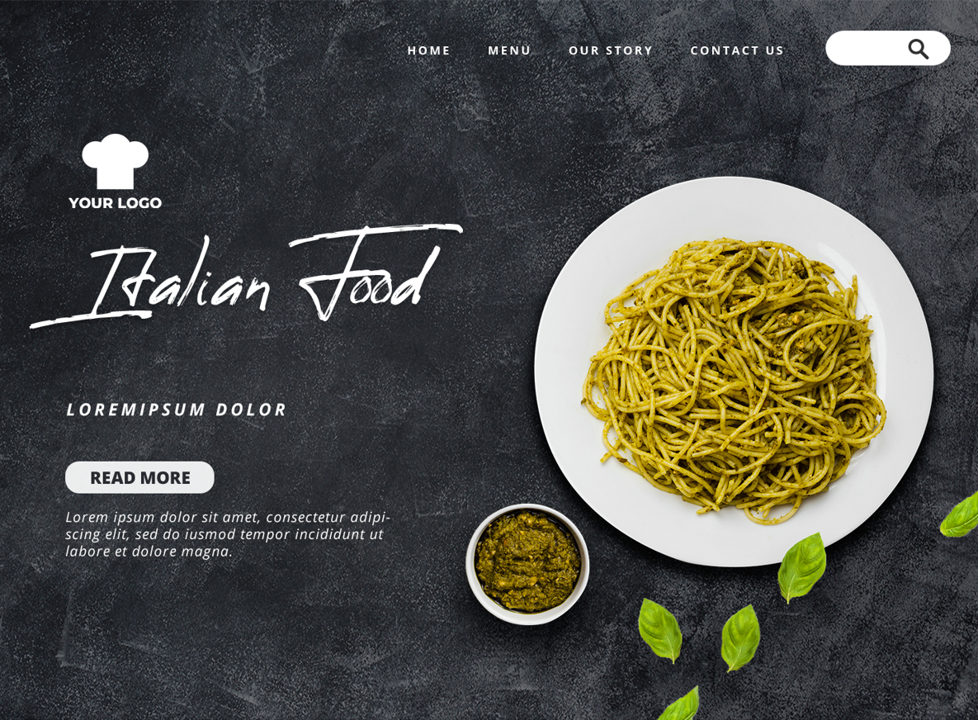
Page - 24
Visual Output: https://italian-restaurant-five.vercel.app/
Unwrapping Our Digital Trattoria :- A Sneak Peek at the Website Through Mockup Photos
First Look: A Welcoming Homepage for the Italian Food Website.

Slide 25
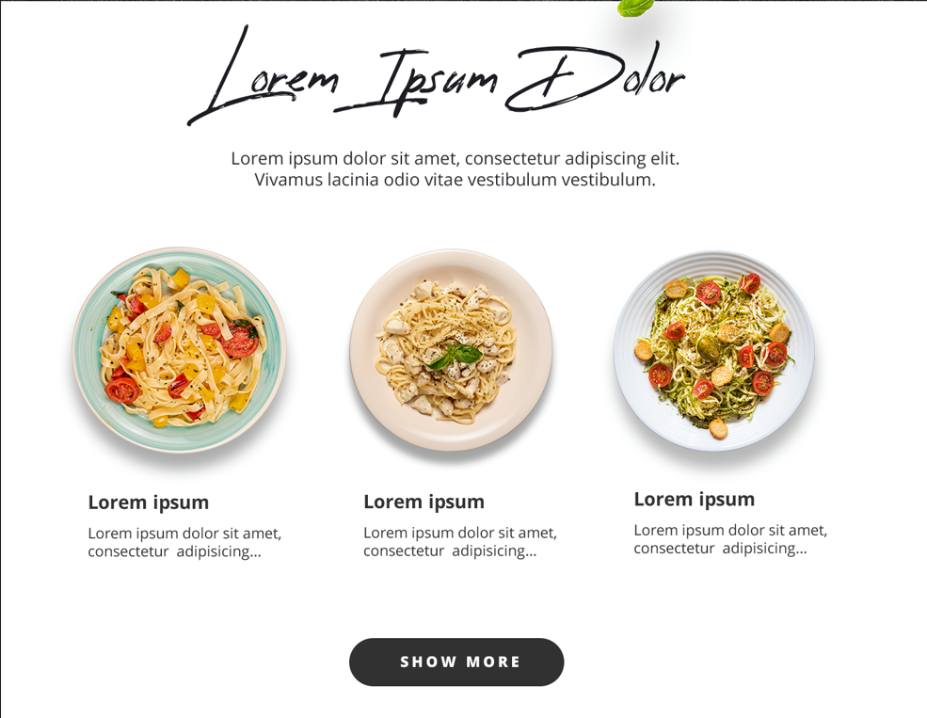
Page - 25
Beyond the Banner: Explore Our Second Page's Visual Pasta Symphony
Unveil a world of flavors and textures, where each image sings a delicious aria in this celebration of all things pasta.

Slide 26
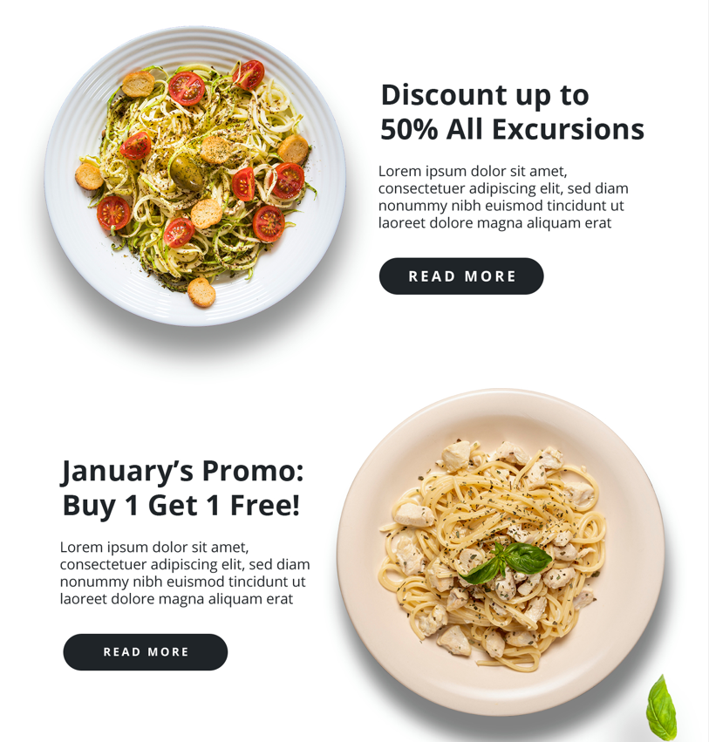
Page - 26
Discounted Discovery: A Third-Page Mockup Beckons You to Explore

Slide 27
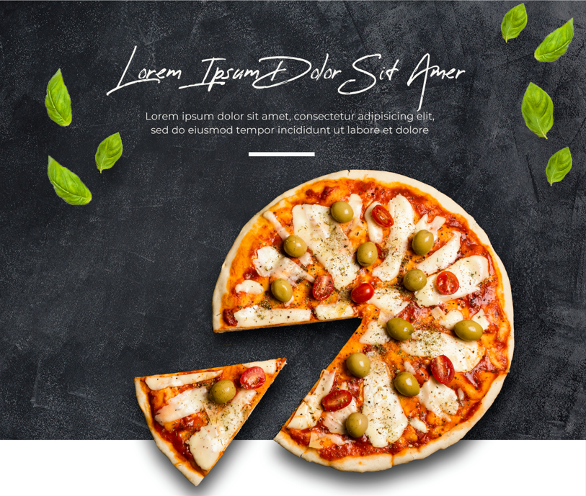
Page - 27
Calling All Pizza Lovers: A Fourth-Page Mockup to Fuel Your Cravings
Dive into a visual feast on this page, showcasing a selection of our mouthwatering pizzas.

Slide 28
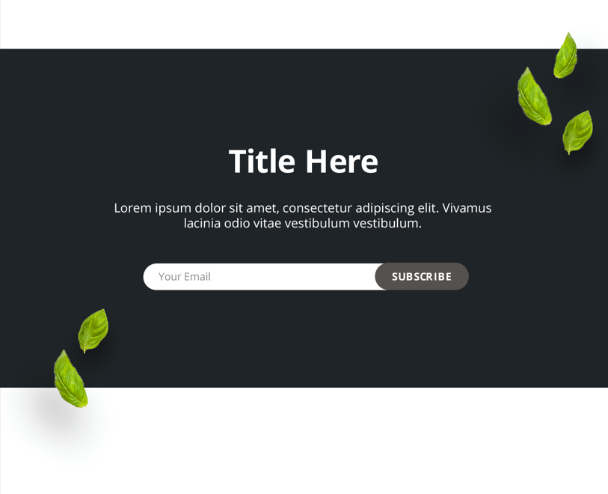
Page - 28
Green Thumbs Up: Fifth-Page Mockup with Fresh Content and a Subscription Invitation
This leafy green design extends a warm welcome, inviting you to explore our fresh content and stay connected. Sign up below to receive updates, promotions, and a taste of what we have to offer!

Slide 29
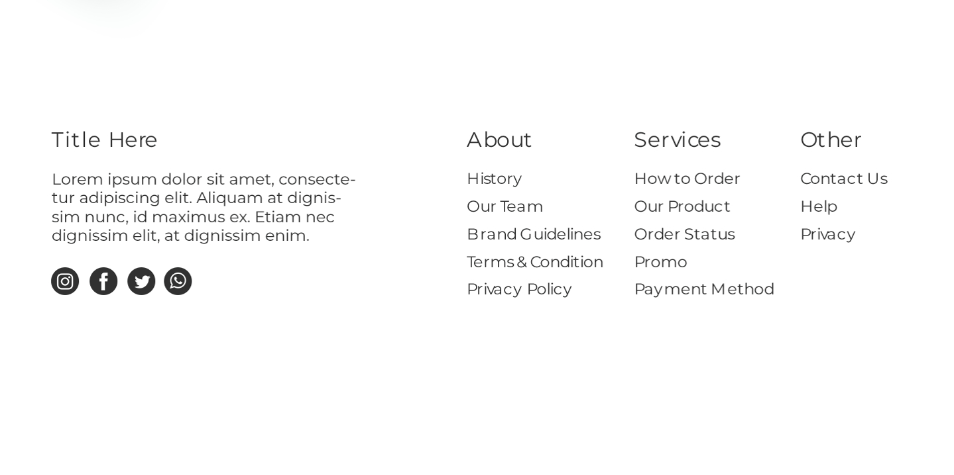
Page - 29
Hungry for Connection? Sixth-Page Mockup Serves Up Social Media and Contact Info.
Craving a taste of community and Italian goodness? Look no further! This page offers all the ingredients for connection, from following our social media buzz to finding our contact information. Dig in and discover new ways to connect with us!

Slide 30
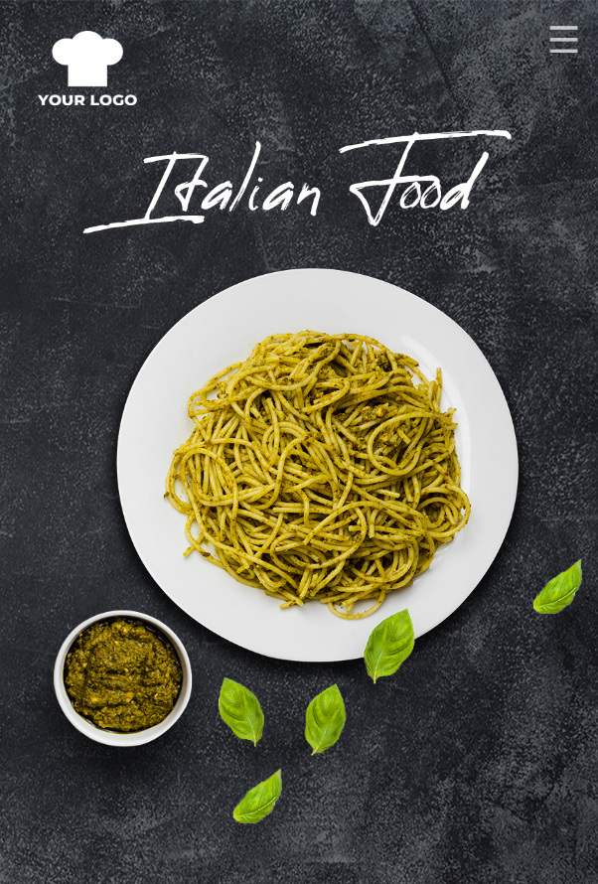
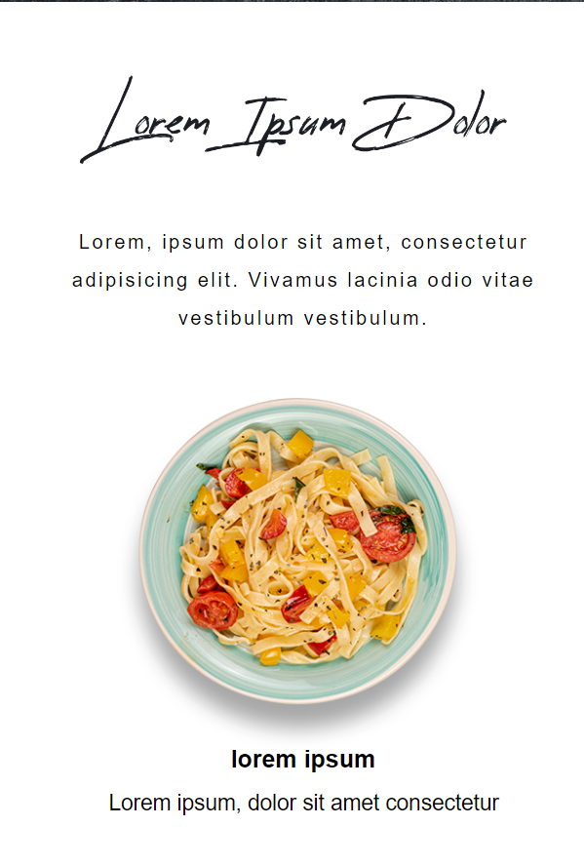
Page - 30
Shrinking Screens, Big Impact:
The Mobile Website Experience
Savory Delights at Your Fingertips
This mobile view snippet showcases the website's adaptation for smaller screens.

Slide 31
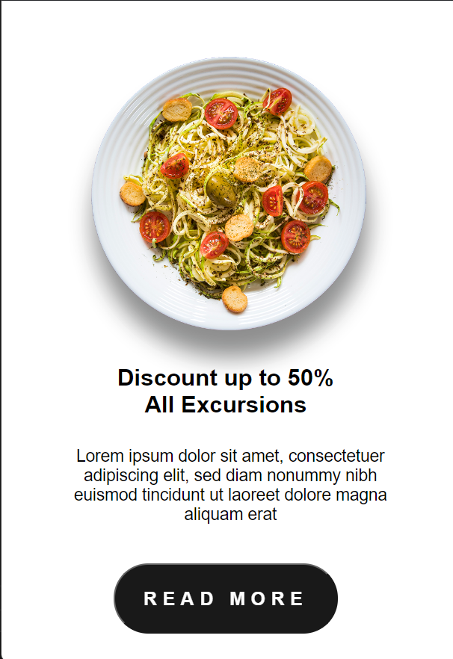
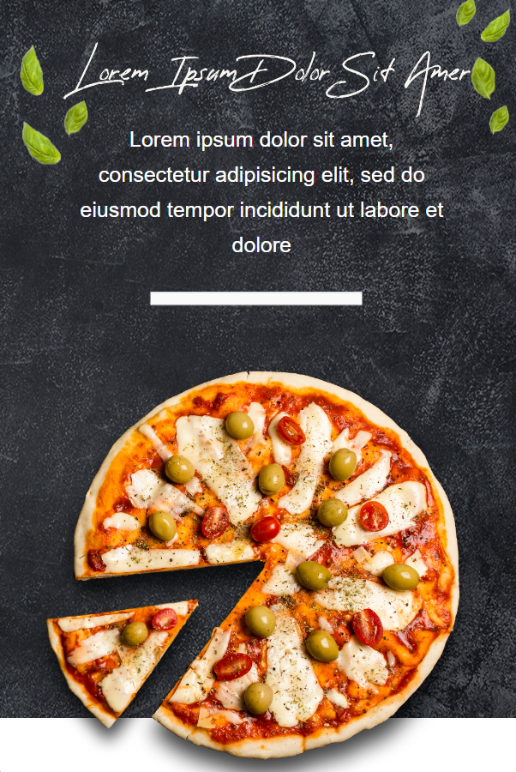
Page - 31
Responsive Design in Action: A Slice of Pizza Perfection on Mobile
This code snippet brings the delicious world of pizza to life on mobile devices. Utilizing responsive design principles, the code ensures the website adapts seamlessly to smaller screens. Imagine browsing mouthwatering pizza options with ease, even on your smartphone.

Slide 32
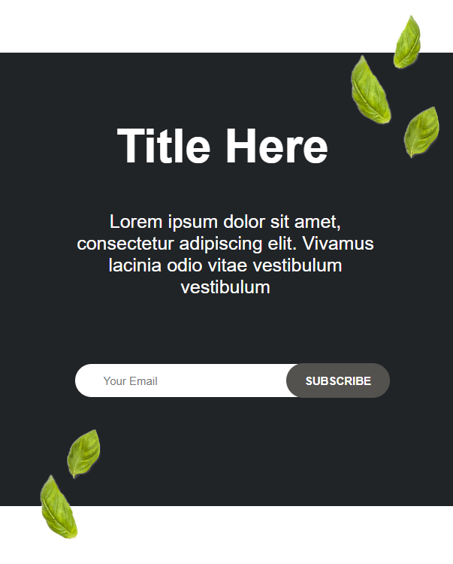
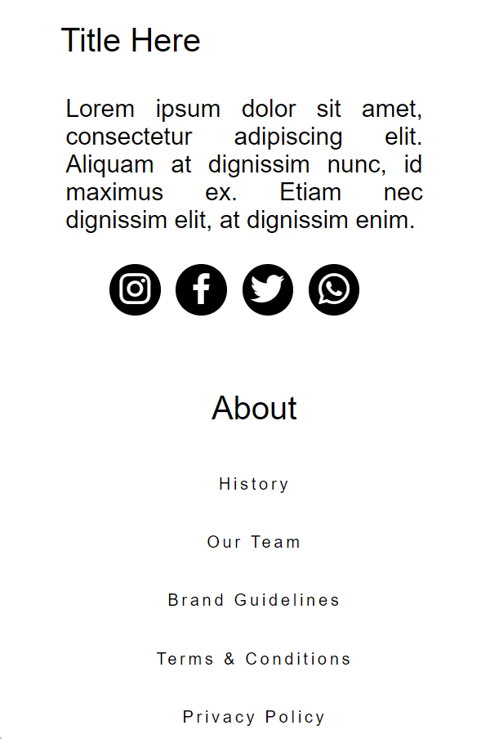
Page - 32
Enhancing the Footer on Mobile: A Look at the Responsive CSS Code
This code snippet offers a closer look at the CSS code that controls the footer section's behavior on mobile devices. The code likely defines styles that take effect when the viewport size falls below a certain threshold.

Slide 33
Page - 4
REFERENCES
WEBSITES
W3SCHOOLS
https://www.w3schools.com/html/
2. MDN WEB
https://developer.mozilla.org/en-US/docs/Web/HTML/
BOOKS
1. HTML & CSS: Design and Build Web Sites
2. Learning Web Design: A Beginner's Guide to HTML, CSS, JavaScript, and Web Graphics

